Slide 1
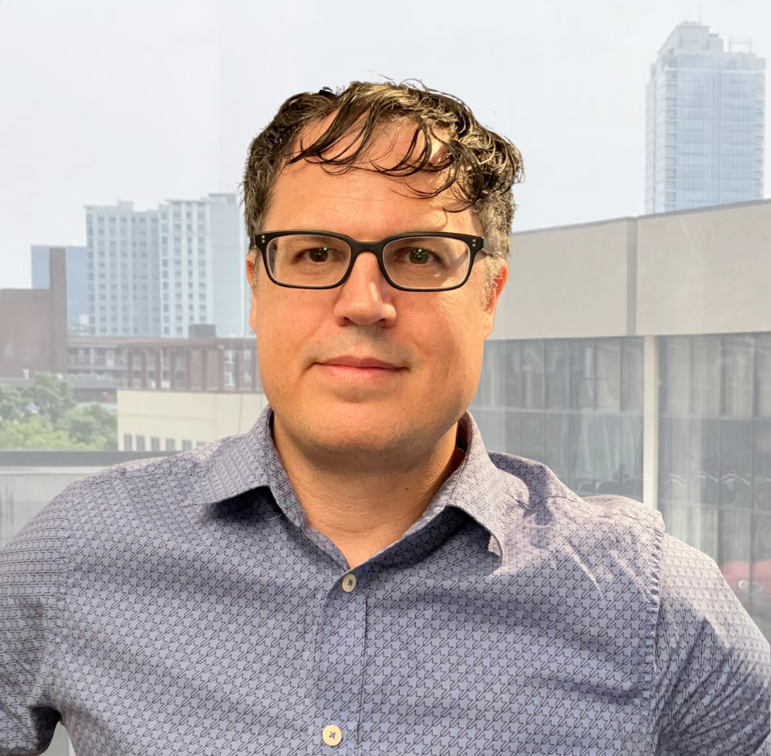

Ronald C. Morse
Highlights Portfolio
Prepared for:

Slide 2






Operations Leadership & Process Innovation
Turning daily challenges into scalable systems
Directed the operational backbone of a growing insurance agency, managing core functions such as CRM systems, document management systems, knowledge-sharing, compliance, onboarding, and more.
Designed, tested, and implemented SOPs across sales, marketing, accounting, and compliance.
Identify Issue
Hands-On Fix & Refine
Gain Consensus
Document SOP
Delegate & Train
Repeat
This iterative approach enabled rapid, efficient scaling, strengthened cross-team collaboration, and freed leadership to focus on growth and strategy.

Slide 3











The Right Hand of the CEO
Trusted, Discreet, and Always Two Steps Ahead
Acted as the CEO’s trusted confidant and right-hand, anticipating needs and addressing issues before they surfaced. Maintained discretion and professionalism as the first call in crises.
Turned rough concepts into polished presentations and communications. Delivered data analysis, research, and feasibility studies to guide decisions.
Orchestrated the back-end of sales, training, and morale-building meetings, ensuring flawless execution under pressure, often serving as an Executive Assistant in all but title, enabling leadership to stay focused on growth and strategy.
Adaptability
Discretion / Confidentiality
Stakeholder Liaison
Proactive / Foresight
Presentation Design
Meeting & Event
Logistics
Executive Coordination
Crisis Response
Research / Feasibility
Data Analysis
In a small business environment, every team member needs to wear many hats — and Ronald wore them all with expertise, enthusiasm, and dependability.
Brian E. Rogers
CEO, Stamford Insurance Group

Slide 4
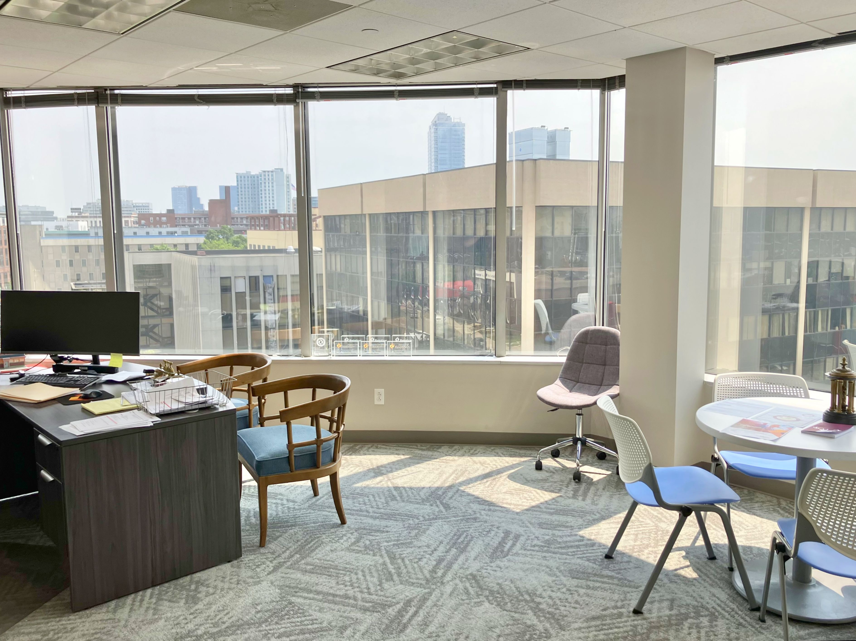
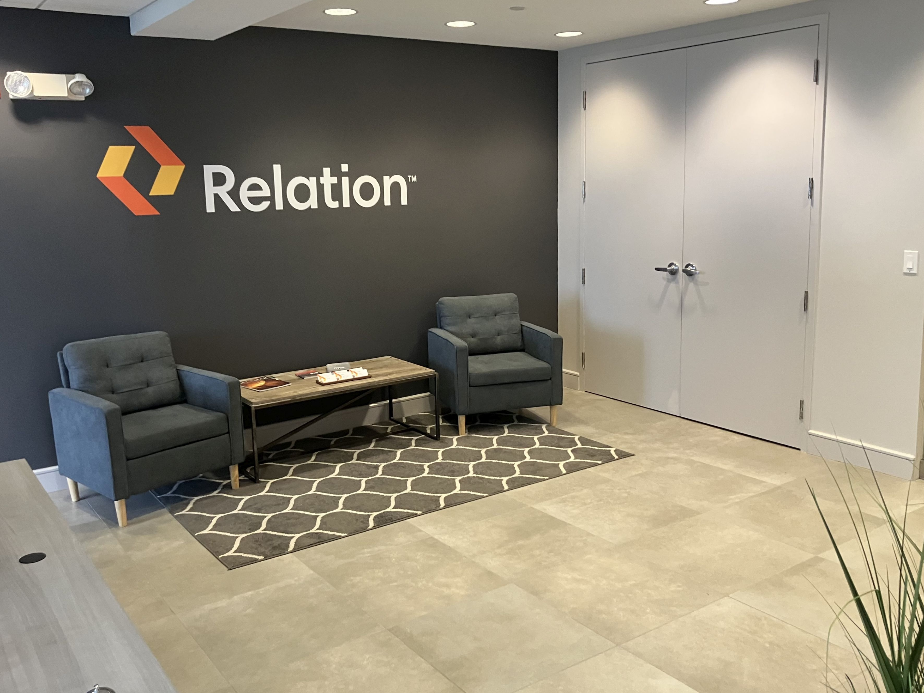
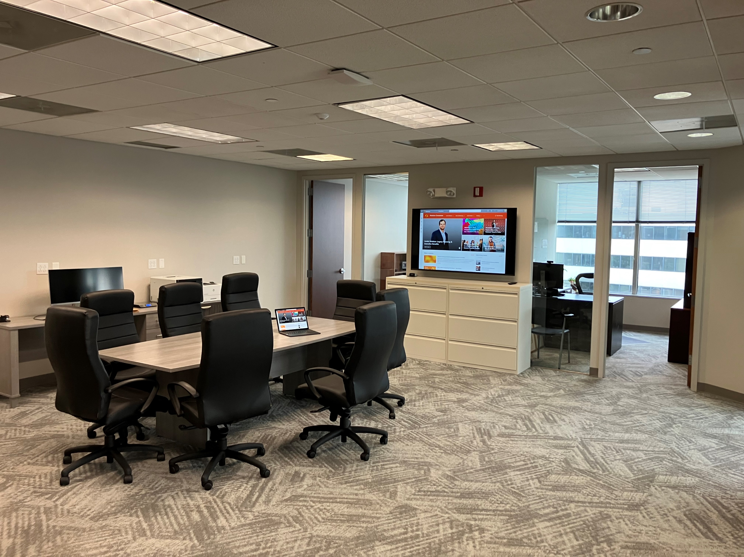
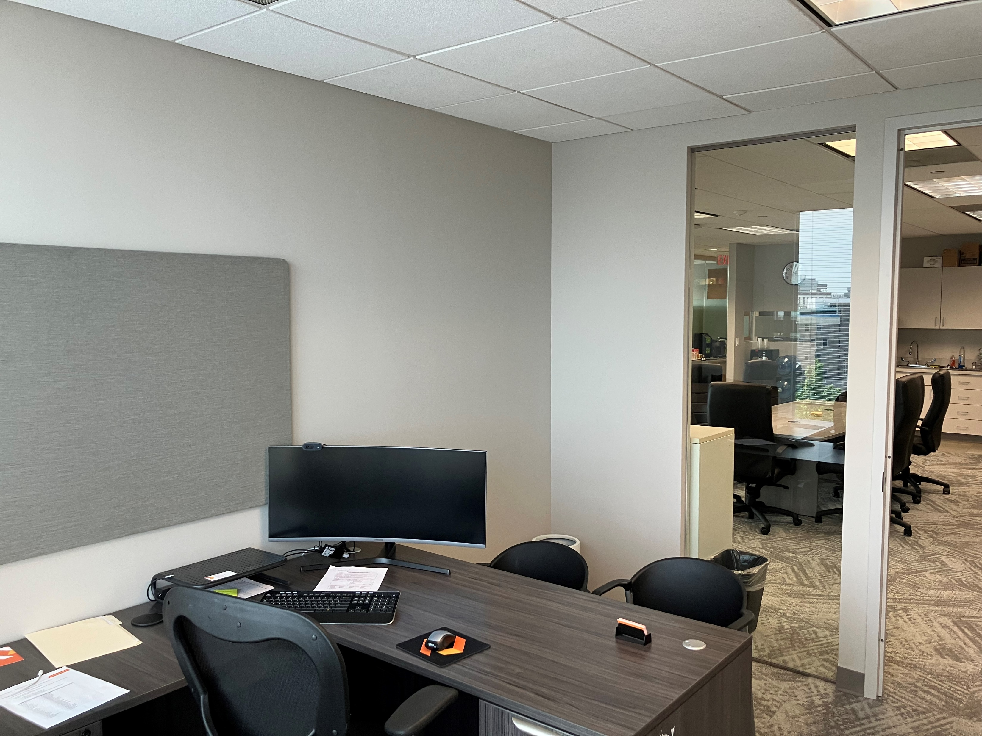
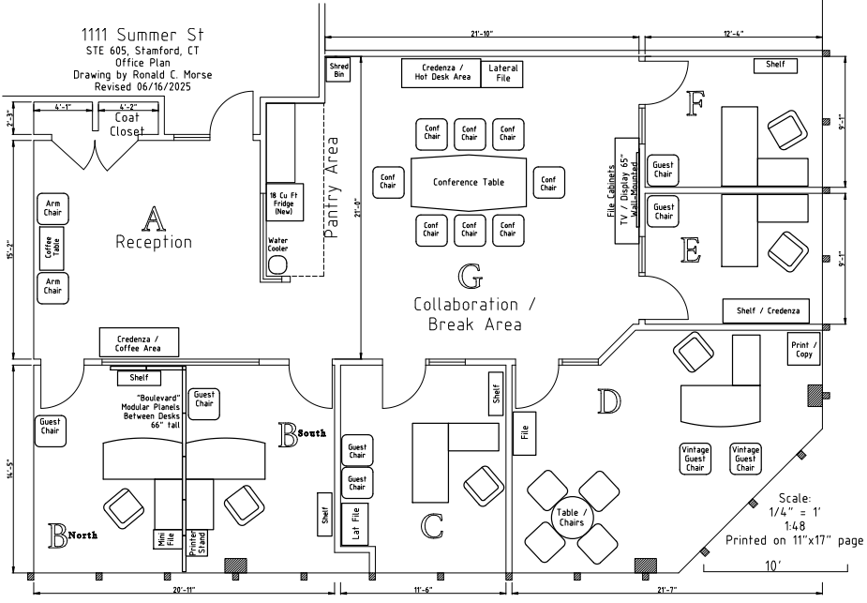
Project: Office Move – Stamford CT location
Exceptional Workplace Experience with Zero Downtime and Cost Savings
Led and executed all aspects of a strategic office relocation from a 5,000+ sq. ft. space to a right-sized facility for a 7-person team.
Achieved virtually zero downtime, reduced monthly costs by thousands of dollars, and delivered a flagship, HQ-quality workspace tailored to our niche market and high-value sales and service teams.
Executive Office
Branded Reception
Central Collaboration
Associate Offices

Slide 5






Project: Communications Consolidation - East Coast
Brought Order to the Chaos for 100 office sites and 400+ users
Managed consolidation of phone systems across 100 East Coast offices, eliminating inconsistent menus and routing failures that left customers at dead ends.
Partnered with leadership to design a unified routing plan that merged service teams while preserving local sales support.
Drove execution hands-on, quickly resolving issues, boosting team efficiency, and improving the customer experience.
Enabled visibility and reporting, making business intelligence possible and preparing the organization for automated service call routing.
Before:
Multiple Dead-Ends
Underutilized or Overworked Teams
Lack of BI Data
?
After:
Happy Clients & Stakeholders
Fully Utilized Teams
Useful Data

Slide 6








Project: M&A / Office Integration - Brooklyn CT
From Strategy Sessions to On-Site Execution: Every Detail Covered
Took charge of integrating a newly acquired office and business with new employees, reams of ancient paper files, failing hardware and scattered electronic data to secure.
Juggling IT migrations, telecom upgrades, and vendor consolidation while handling space planning, signage, and training. One moment finalizing budgets with leadership, the next configuring network gear or crafting marketing announcements.
Coordinated teams, vendors, and employees to deliver a fully operational, branded, and compliant location smoothly, on time, and without missing a beat.
Project Snapshot:
To Do
In Progress
Waiting on 3rd Party
Done
Project Closure & Reporting
File &
E-Data
Audit
Former
Owner Interview
Internal Announce
Scope & Budget Approvals
Vendor Consolidate
Signage Design & Install
Lease/
Utilities Takeover
Site Survey
Office Declutter/
Organize
Furniture Upgrades
Space Planning
Conference room AV
Telephony
UCaaS Integration
Hardware Refresh
Provision
VPN
Network Upgrade
AD Onboarding
Paper File Digitization
Marketing Announce
New Employee Training
Insurance Carrier Onboarding
HR Onboarding
CRM Onboarding
Fully integrated the new office and business unit in under 6 weeks, minimizing downtime and aligning systems, procedures, and staff.
OUTCOME:

Slide 7
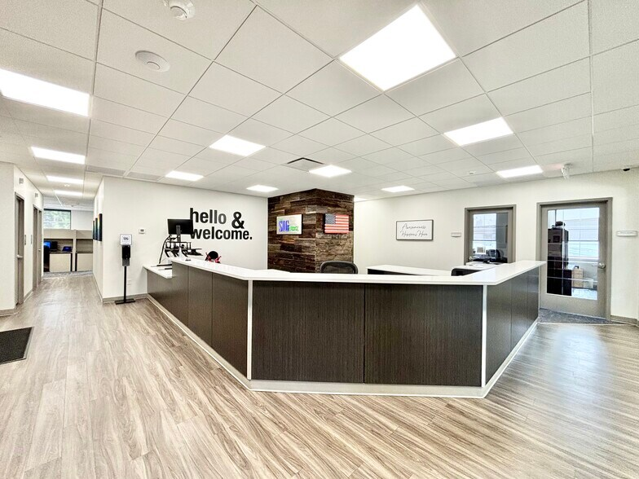
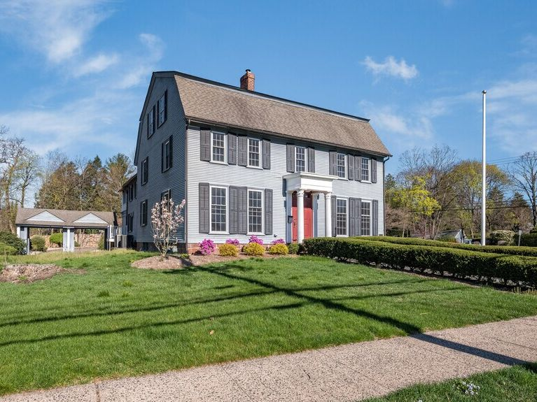
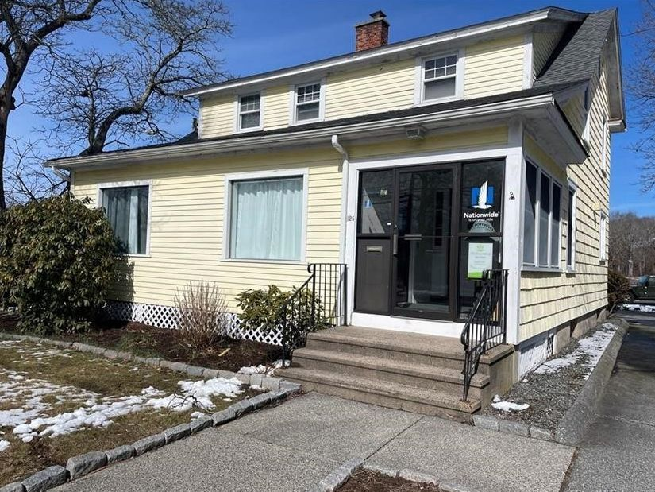
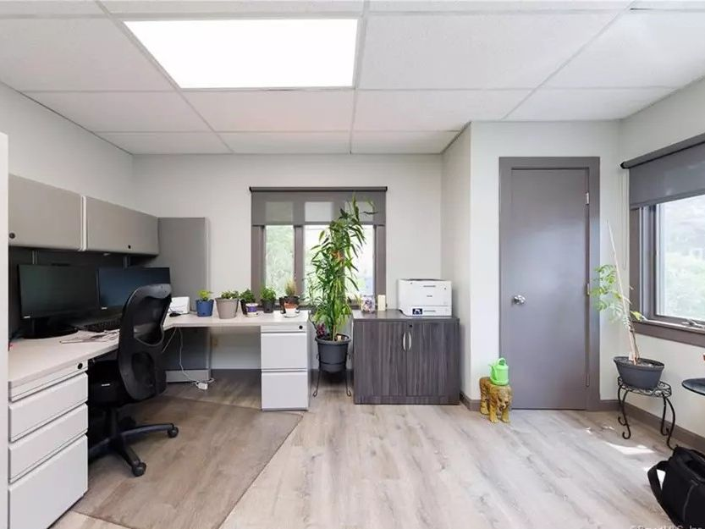
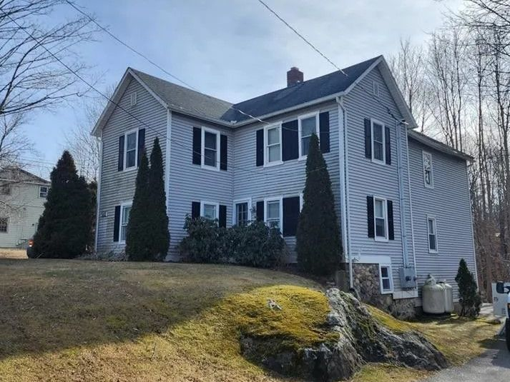
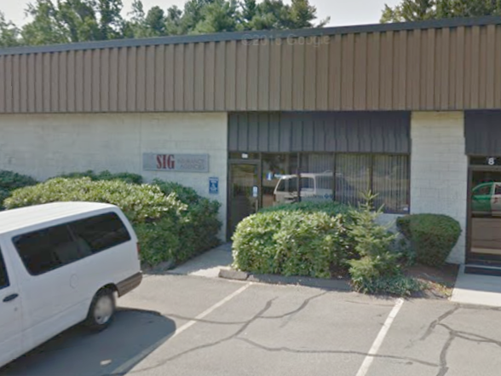
Facilities and Property Management
Two Roles, One Mission: Balancing Ownership & Business Operations
Most property managers focus on the building. Most operations managers focus on the business inside it. I did both, at the same time.
Managed both the physical assets and business operations for 6 properties personally owned by CEO and COO, balancing owner priorities with the needs of a fast-paced insurance operation.
Over the years, also directed daily operations, build-outs, moves, etc. for 20+ rented office locations, with a maximum of 13 offices in operation at once, ensuring real estate assets and the business were at their peak performance.
Stamford CT: 5,000 sq ft
Gut renovation, 15-employee cap.
Cheshire CT: 4,000 sq ft,
Full interior update, 20-employee cap.
Groton CT: 3,800 sq ft
Plus two commercial tenants
Brooklyn CT: 2,000 sq ft
Full interior update
Bantam CT: 2,900 sq ft
Plus residential tenant
Cheshire CT: 3,800 sq ft
Plus commercial tenant

Slide 8
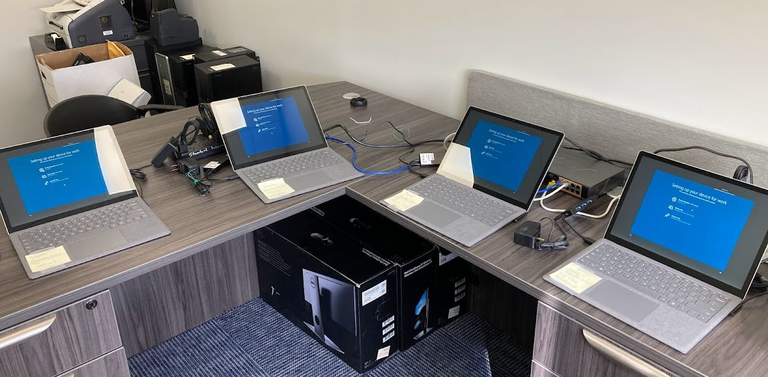
Full-Scope IT Management
Keeping Tech Agile, Adaptable, and Affordable
Managed end-to-end IT infrastructure for a 60+ person, 12-location insurance agency.
Covering everything from strategic planning, software deployment, & hardware provisioning; to networking, security and end-user support, while keeping systems agile and cost-effective.
Partnered closely with leadership to ensure technology aligned with operations, enabling rapid integration of new offices.
Delivered system integrations that employees and stakeholders consistently praised for improving performance and productivity.
Quickly learns new applications and, more impressively, applies them effectively to streamline operations. His initiative in creating custom software solutions significantly improved internal workflows, and his ability to handle both high-level strategy and detailed execution is rare and valuable.
Brian E. Rogers
VP, Relation Insurance
CEO, Stamford Insurance Group
He was key to installations and training for new systems. He exhibited a great deal of patience as the tech support contact for over 65 employees.
Deborah Brosy
Finance Director, Stamford Insurance Group
Ron’s wealth of IT knowledge… made him an invaluable asset. Whether it was working behind the scenes to resolve issues, opening new offices, or setting up new employees for success.
Lisa Lingle
External Growth Lead, Relation Insurance

Slide 9
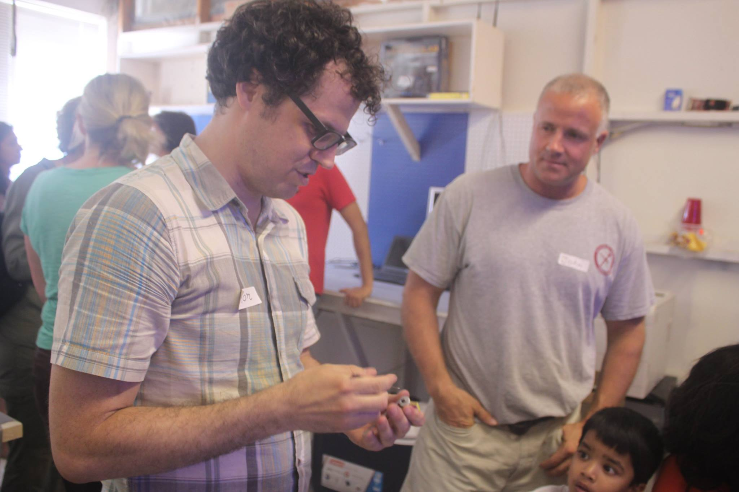
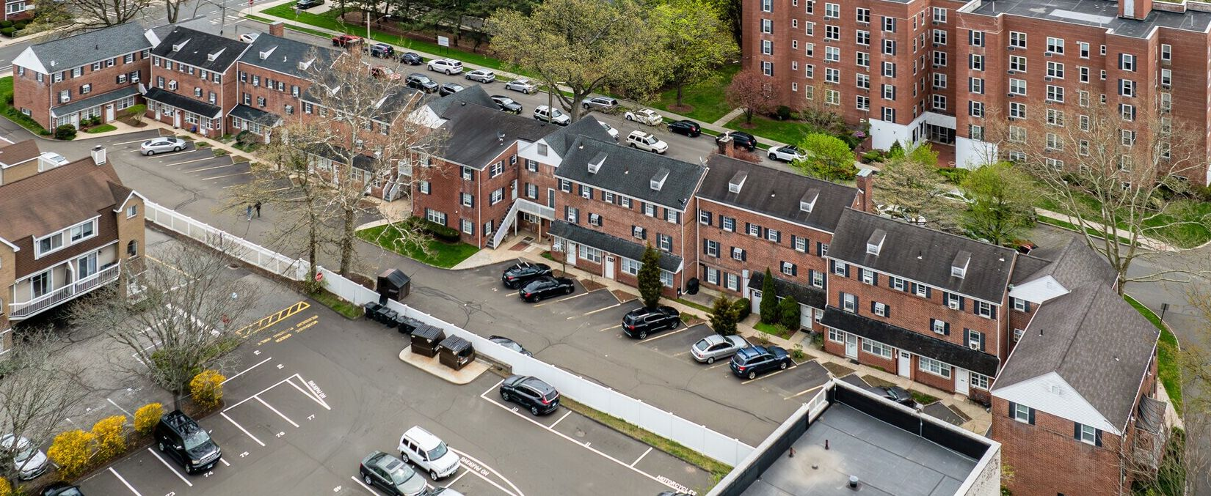
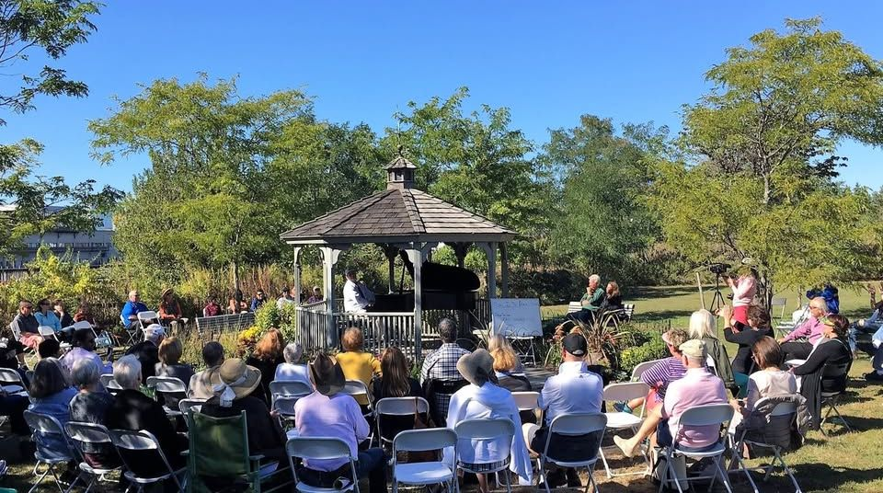
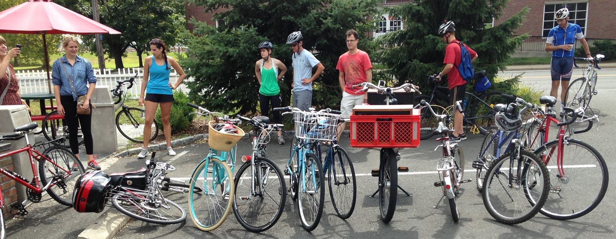
Leadership, Creativity & Community Engagement
Applying strategic thinking, technical expertise, and creativity
Brighton Court Condo Association
President & Condominium Board Member
Led a 37-unit community as President, overseeing property management, major projects, and insurance challenges with transparency and collaboration.
Rippowam Labs Maker Space
Partner, facilities & training
Co-managed a creative workspace, teaching technical and craft skills while fostering collaboration.
Music In the Park at Czescik Marina
Organizer, Publicity & Audio Tech
Helped revive a hidden public space through live music events, handling publicity, logistics, and sound engineering
Community Bicycle Ride Organizer
Led musical group rides to promote healthy lifestyles and goodwill toward urban cycling

Slide 10
Let’s Discuss How I Can Help Your Organization Succeed
“Simplicity and complexity are the same thing, or to state it in other words
–there is a point where simplicity becomes very complex."
Richard M. Palmer: The Lighting Art
Ronald C. Morse • Stamford, CT • 203-559-1671 • ron@ronaldcmorse.com

